Slide 1
Research Update – 3/27/2023
John Lee

Slide 2
Current Work
Linear Correction Junctional Modeling
Pipeline Compilation

Slide 3
Linear Transform/Correction

Slide 4
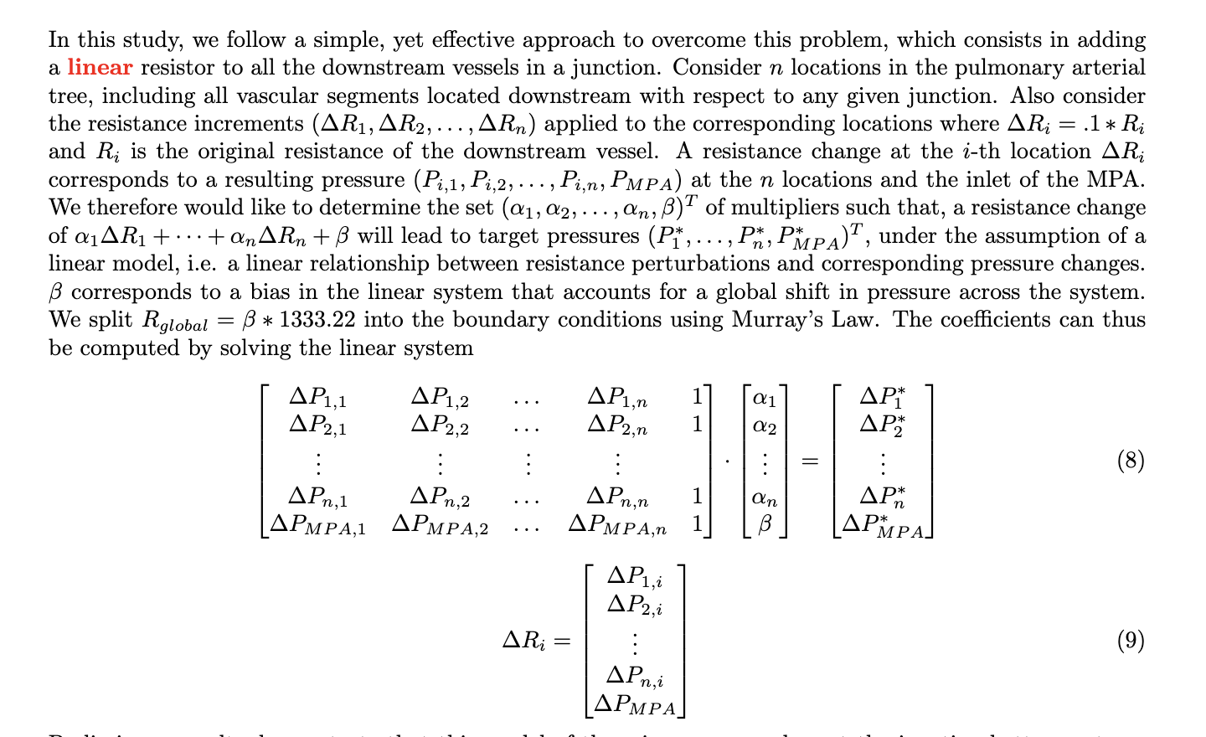
Method

Slide 5
Healthy Model

Slide 6
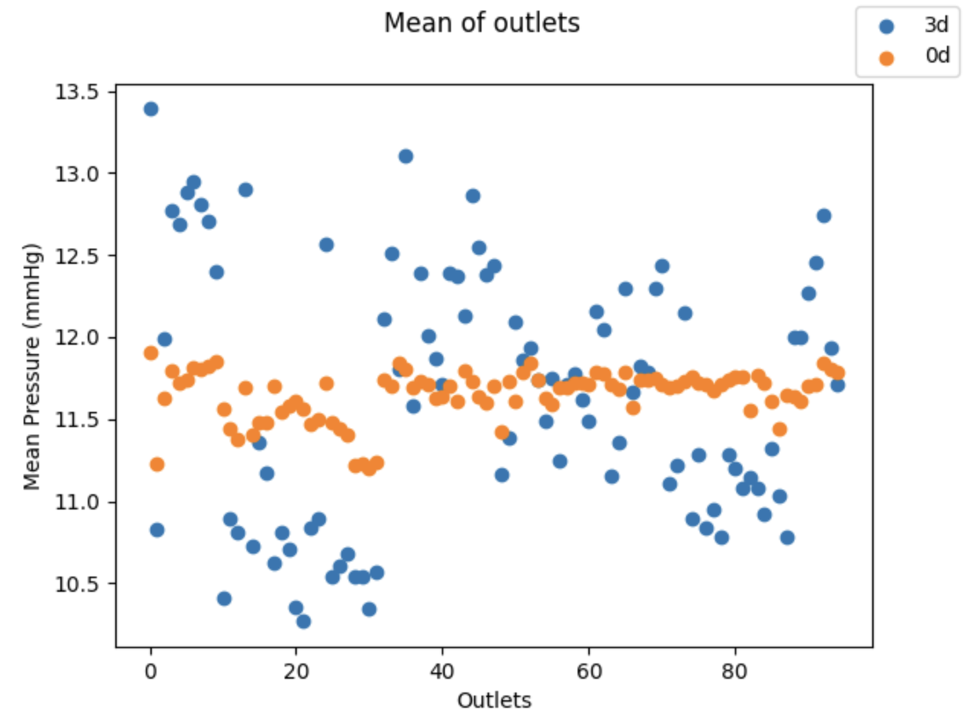
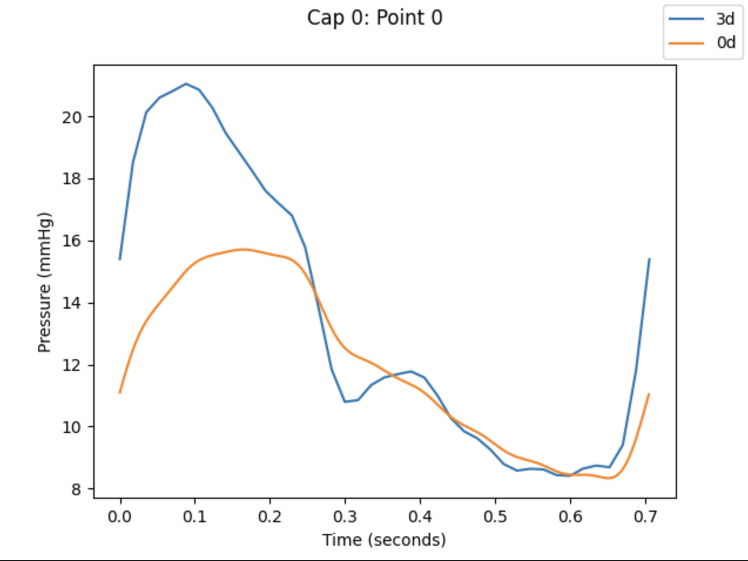
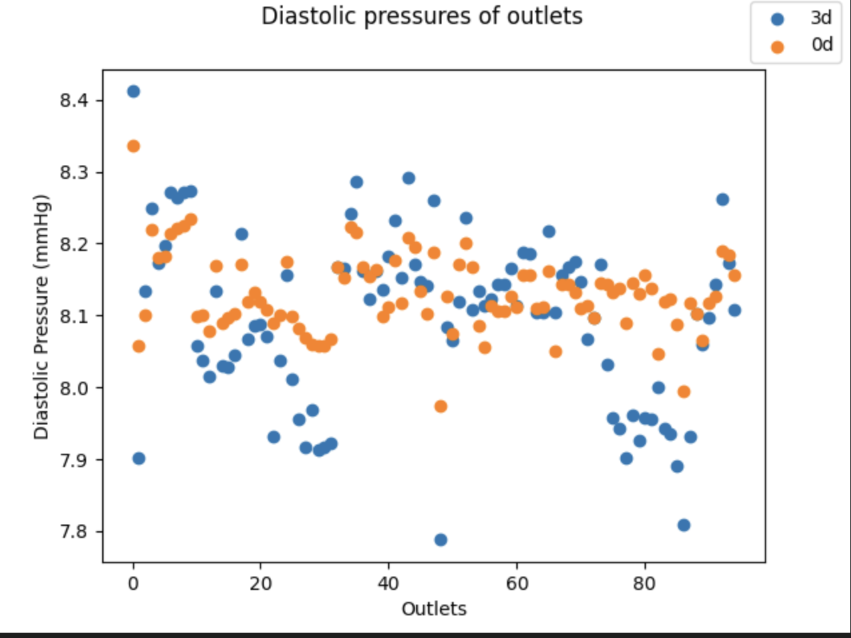
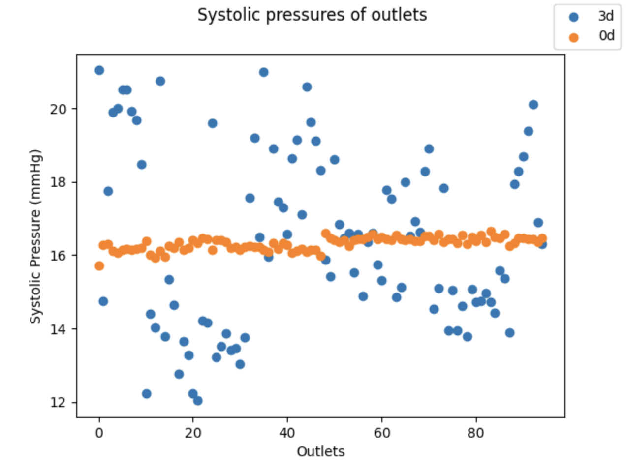
No correction

Slide 7
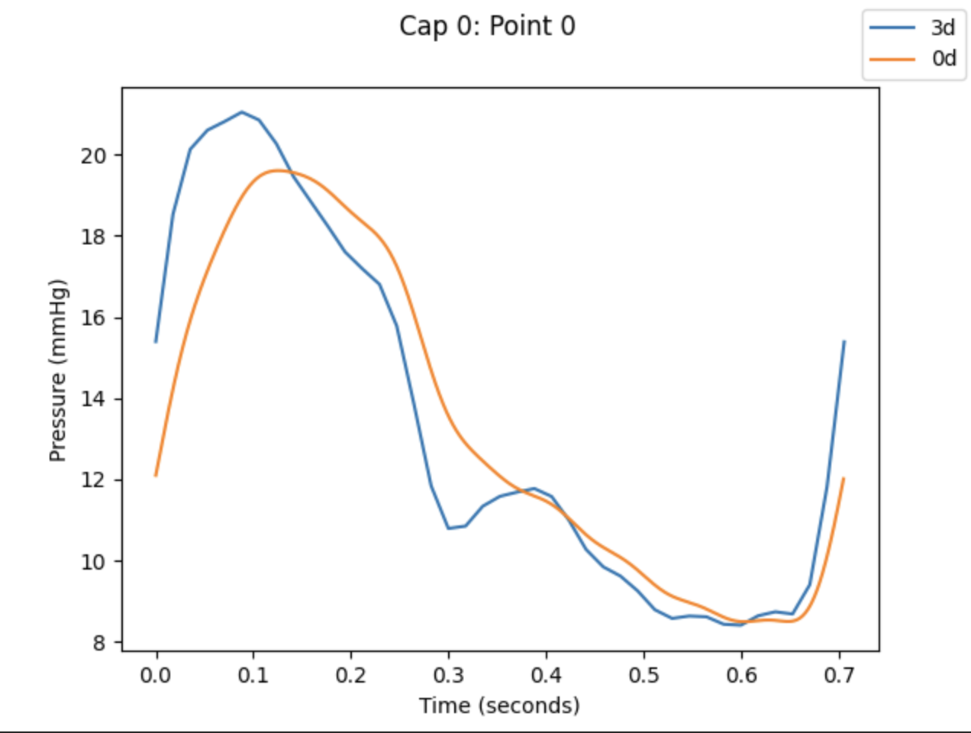
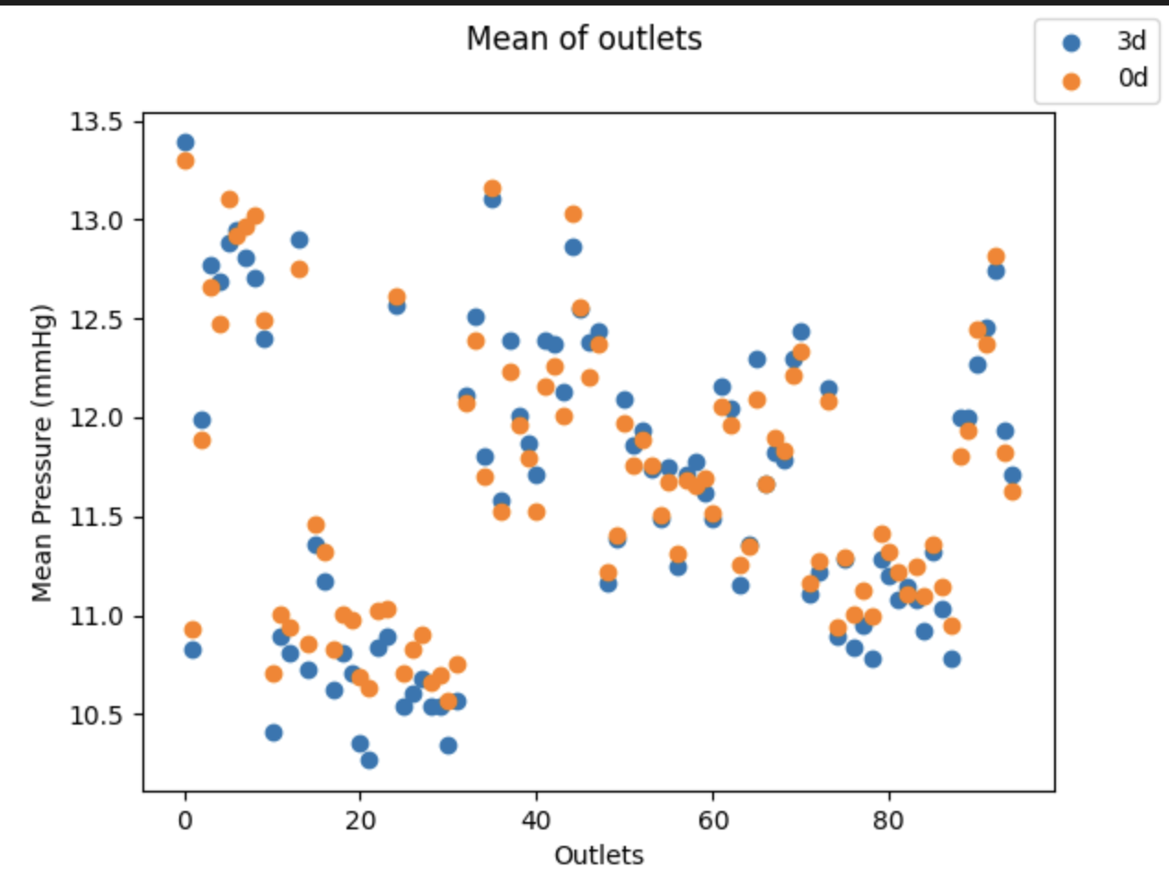
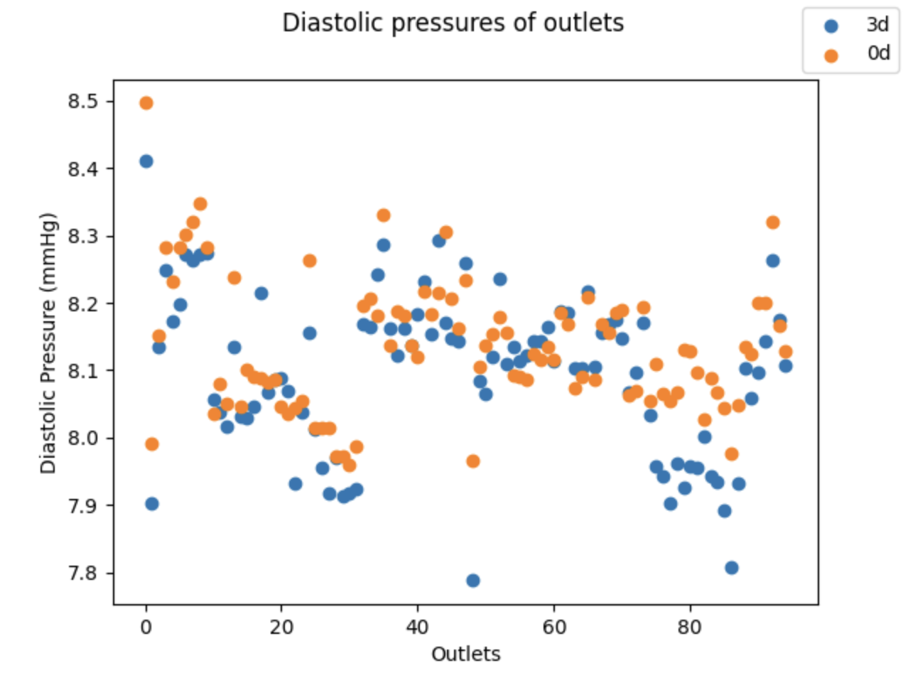
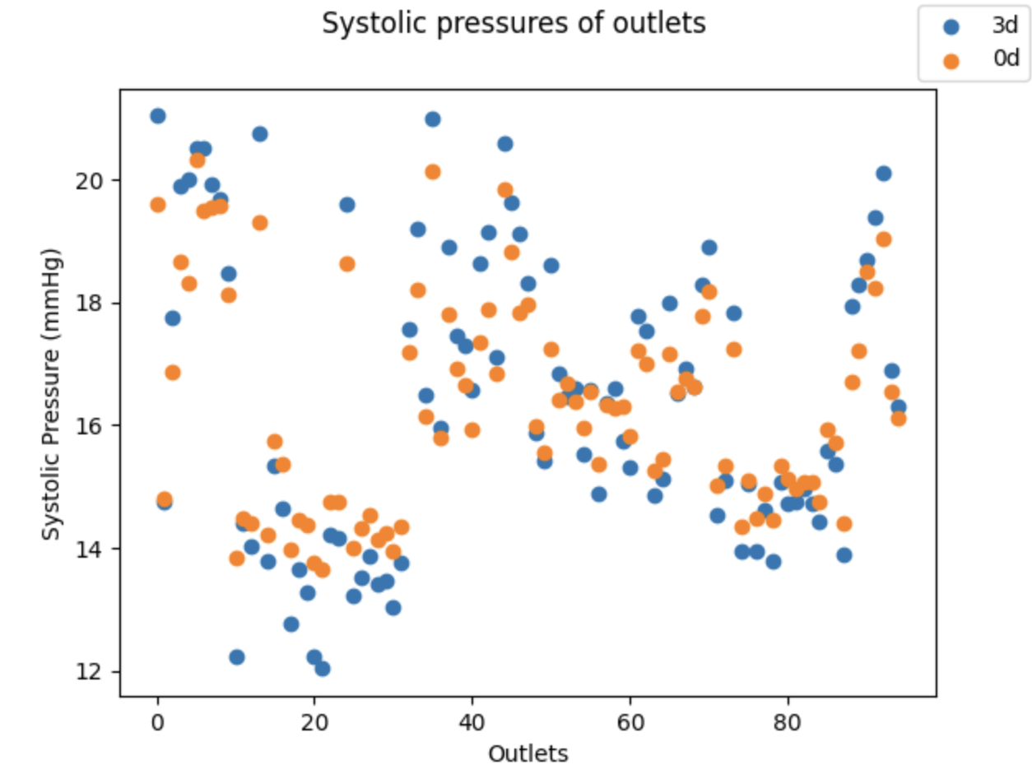
Non-physical correction (There are [-] R)

Slide 8
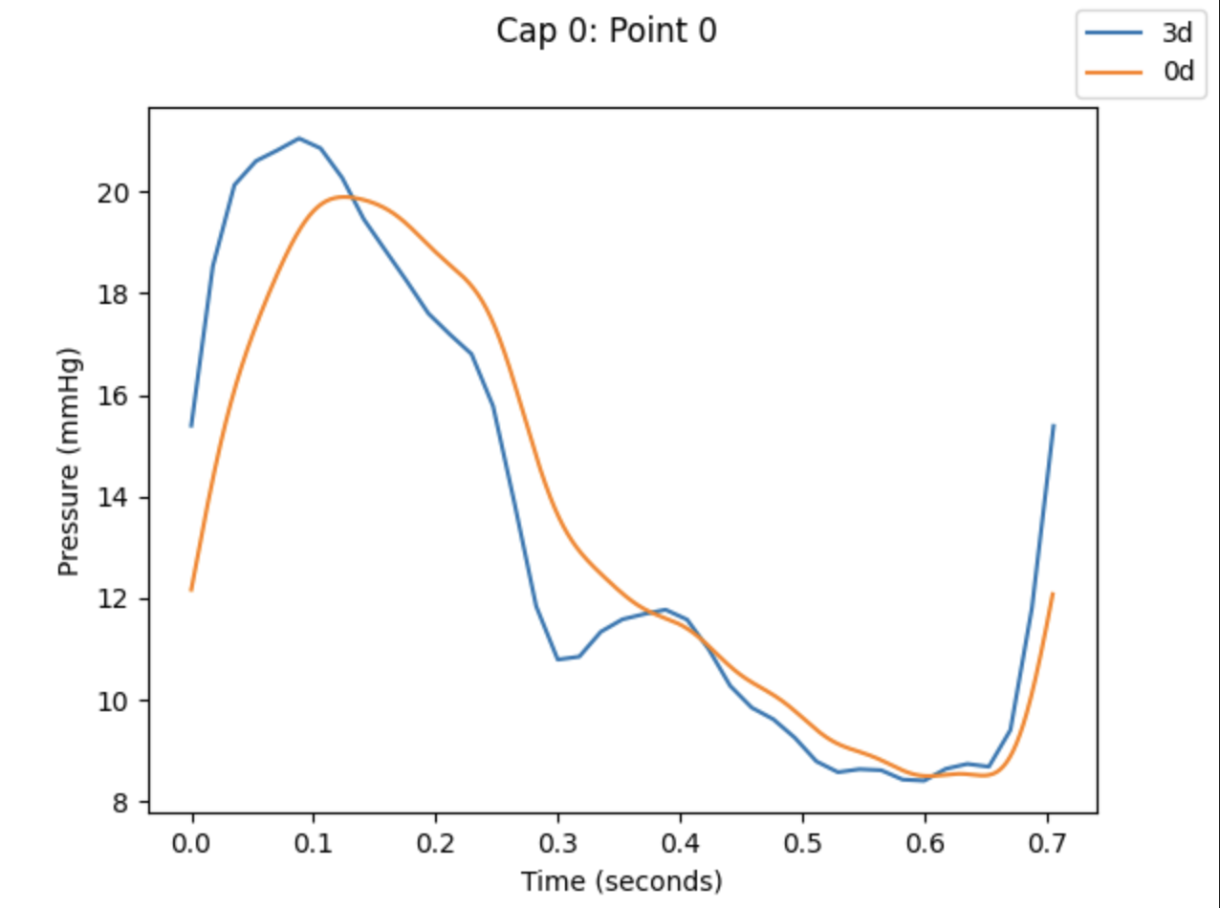
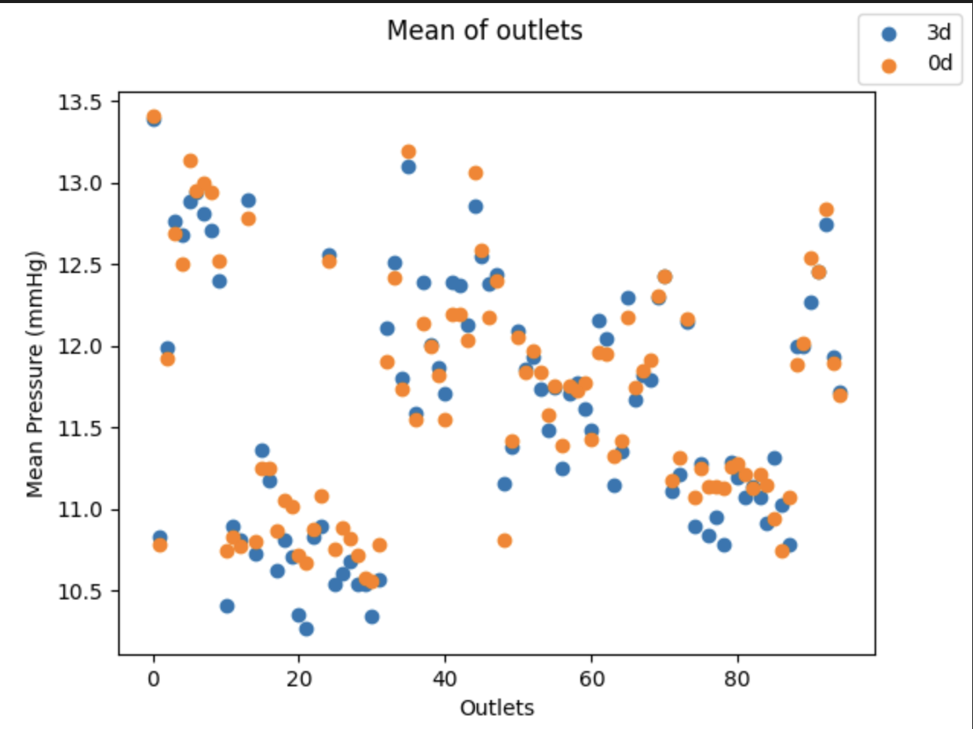
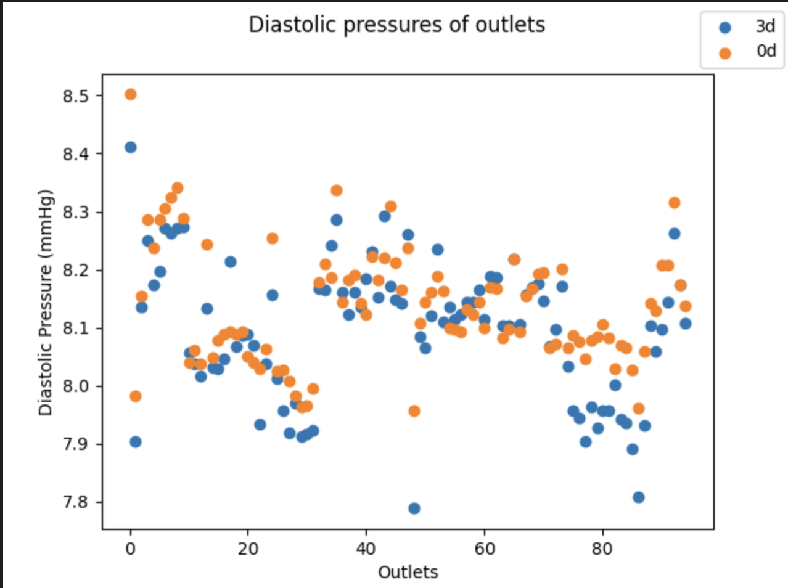
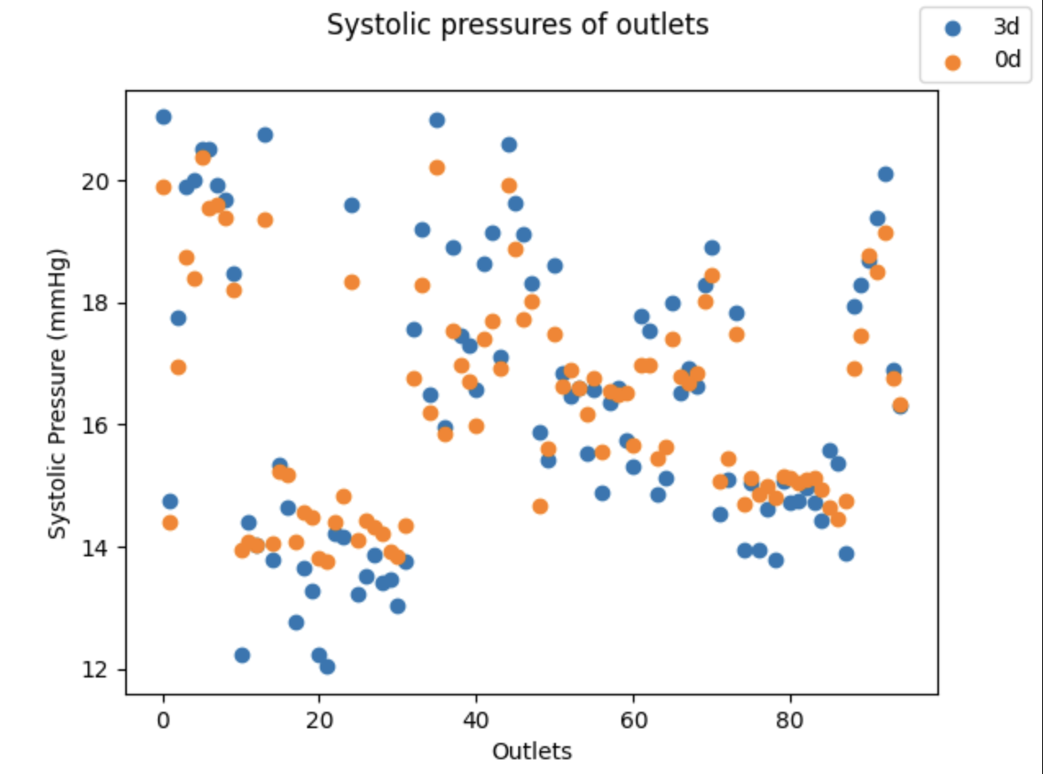
Physical correction (remove [-] R)

Slide 9
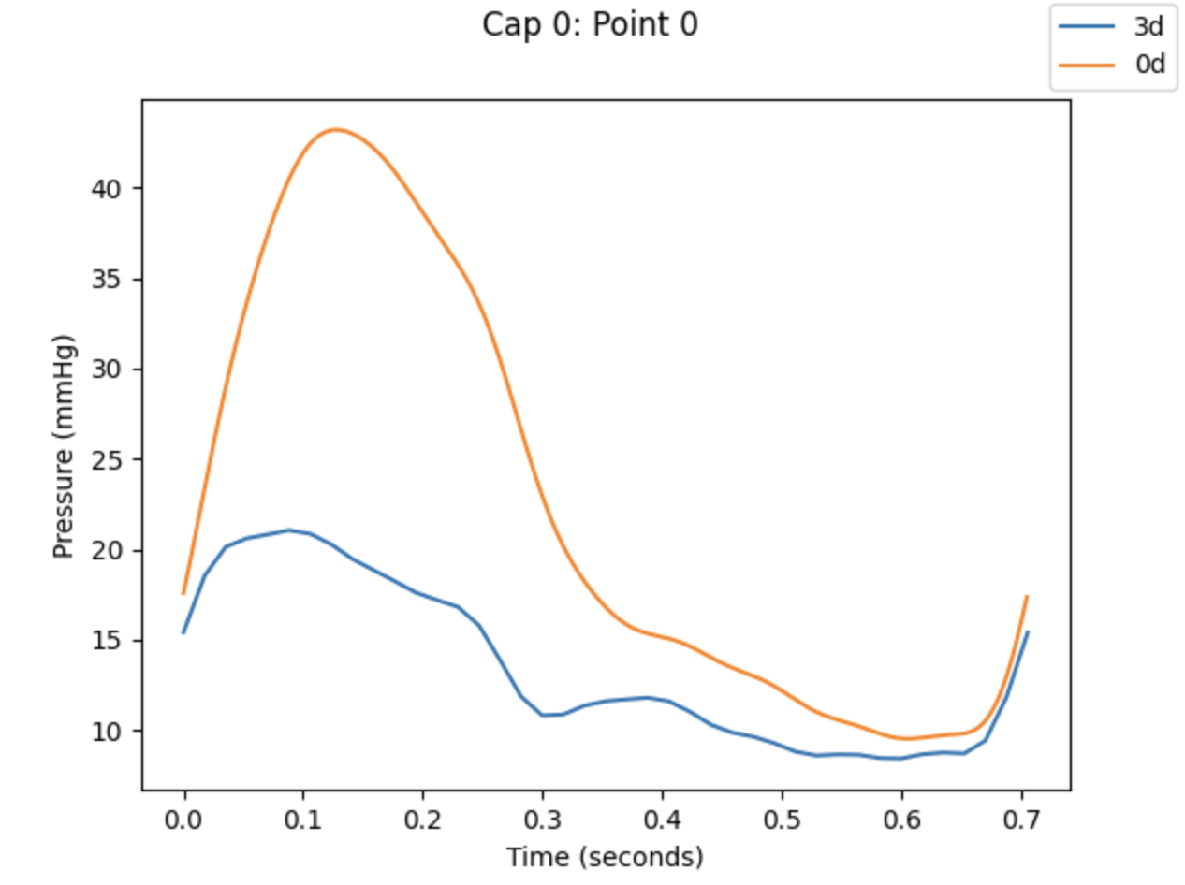
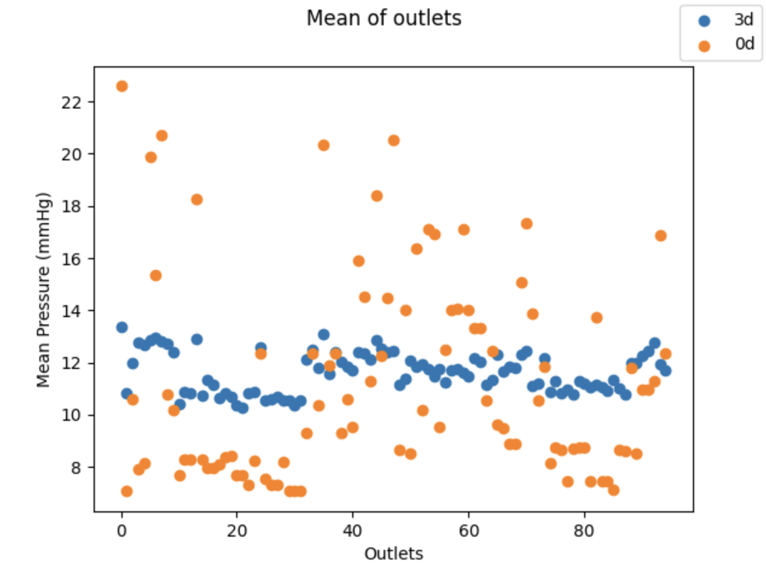
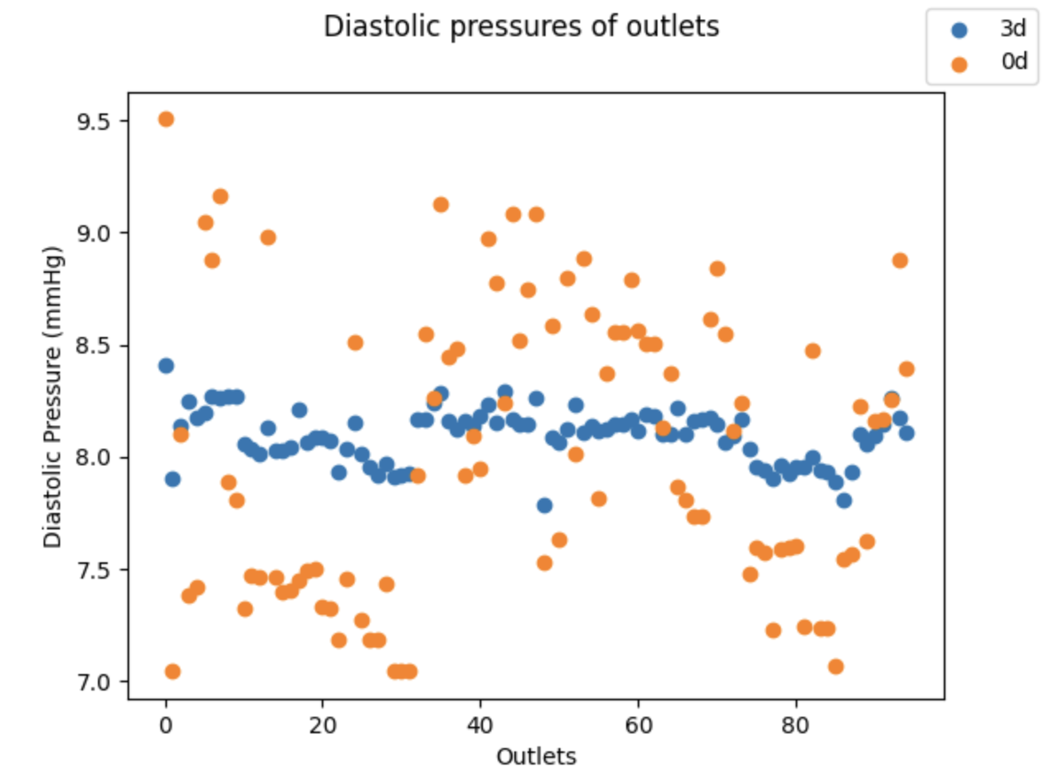
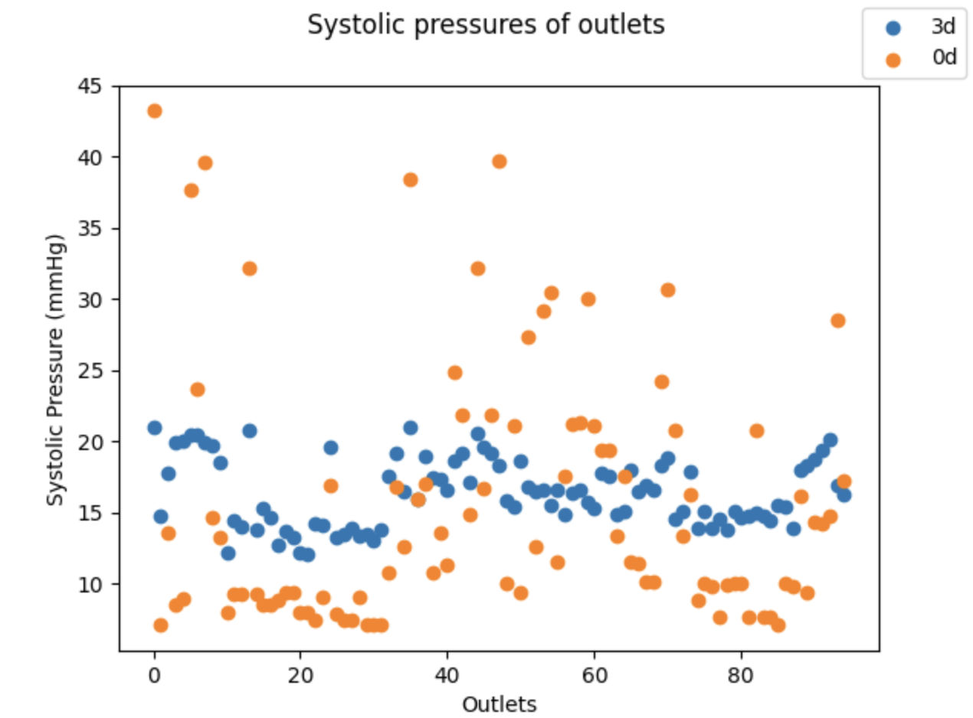
Using Sys/Dia/Mean Correction
Fails b/c @ systole, the difference in pressure is much higher than the mean difference
~4 mmHg @ systole
<1 mmHg for mean.

Slide 10
Errors (across Outlets)
Run | Systolic |  | Mean |  | Diastolic
 | Mean Relative Error | Mean Absolute Error (mmHg) | Mean Relative Error | Mean Absolute Error (mmHg) | Mean Relative Error | Mean Absolute Error (mmHg)
No Correction | 0.127 | 2.062 | 0.049 | 0.578 | 0.008 | 0.067
Non-Physical Correction | 0.037 | 0.611 | 0.010 | 0.120 | 0.007 | 0.056
Physical Correction | 0.039 | 0.638 | 0.011 | 0.130 | 0.007 | 0.054
Triple Correction | 0.381 | 6.31 | 0.244 | 2.84 | 0.061 | .49

Slide 11
Diseased Model
(The 3D model is inaccurate due to insufficient tuning model).

Slide 12
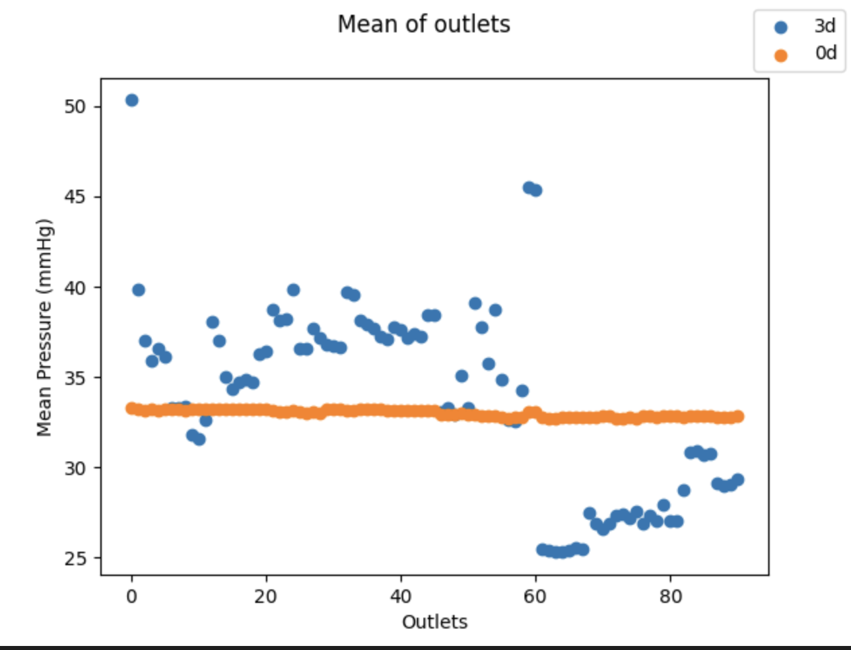
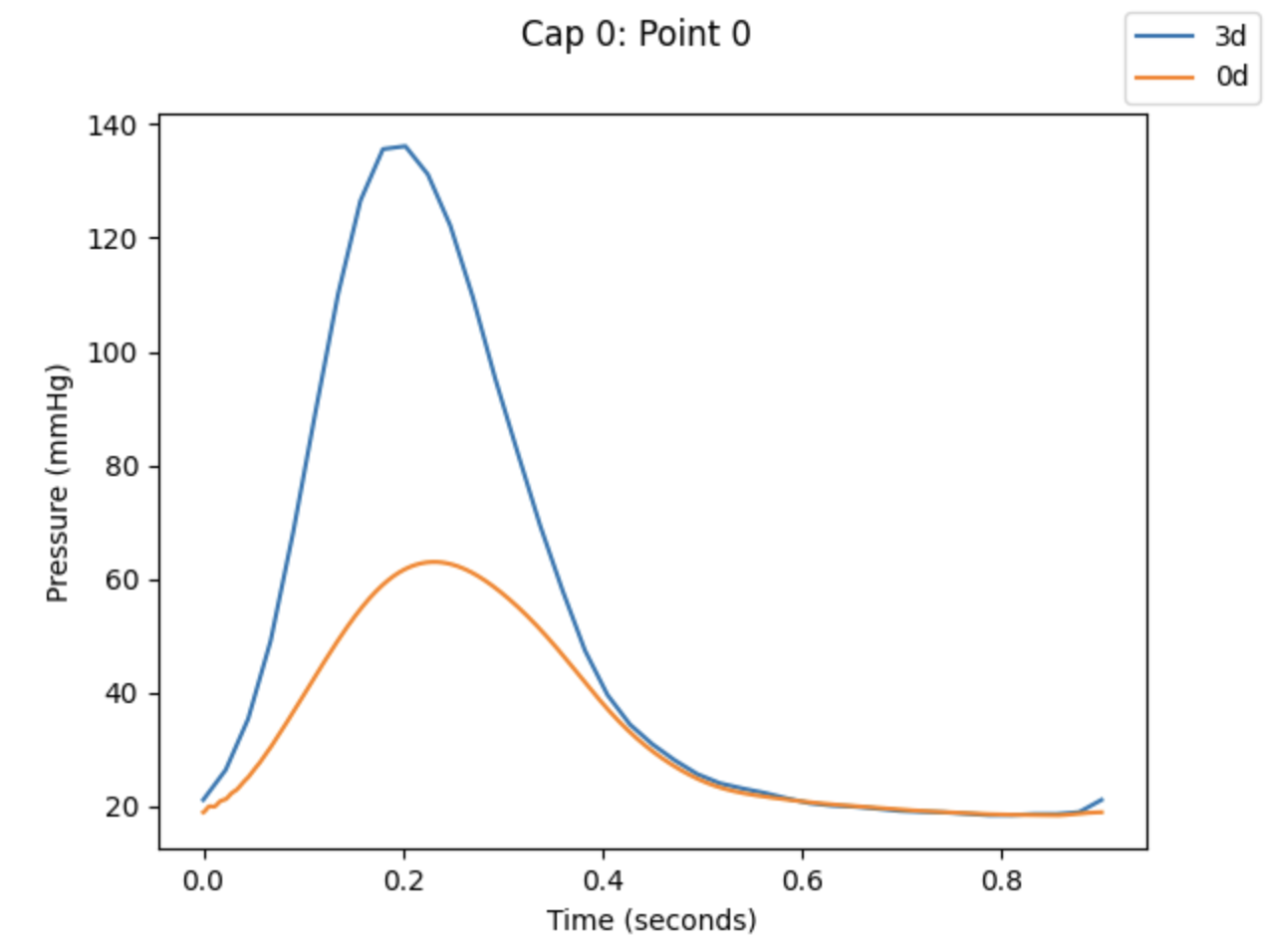
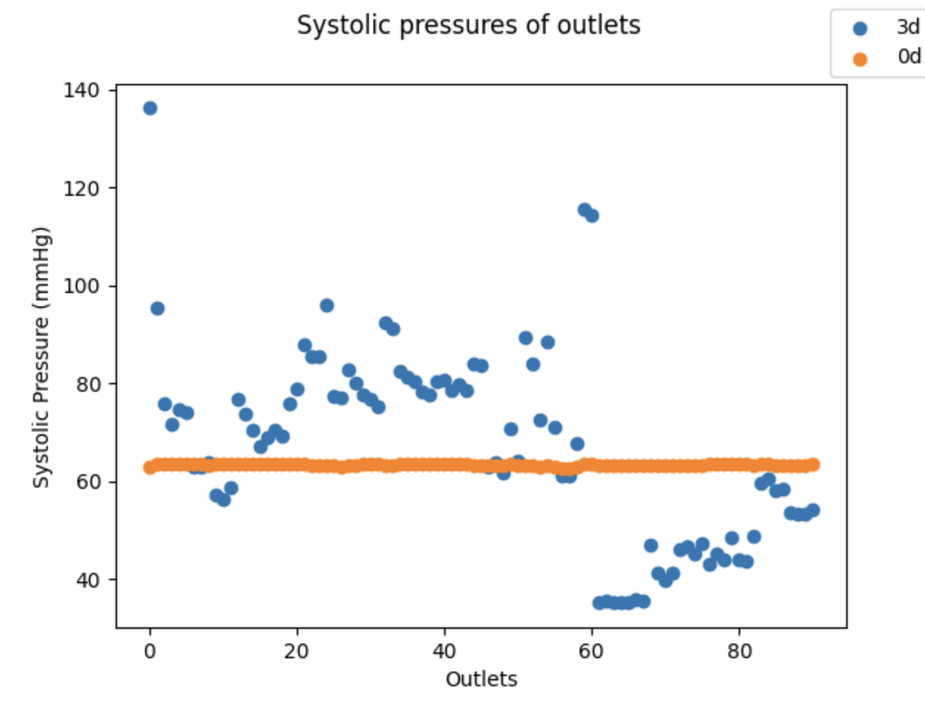
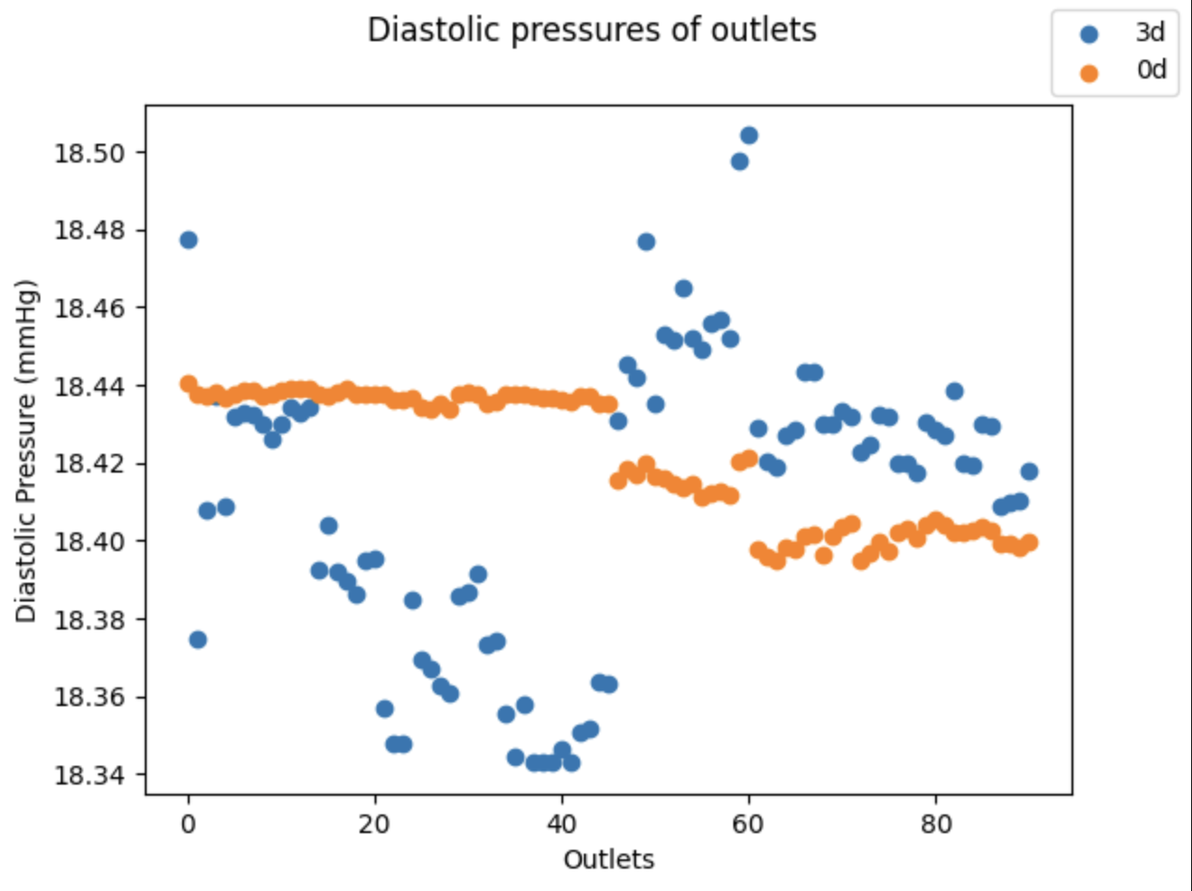
No correction

Slide 13
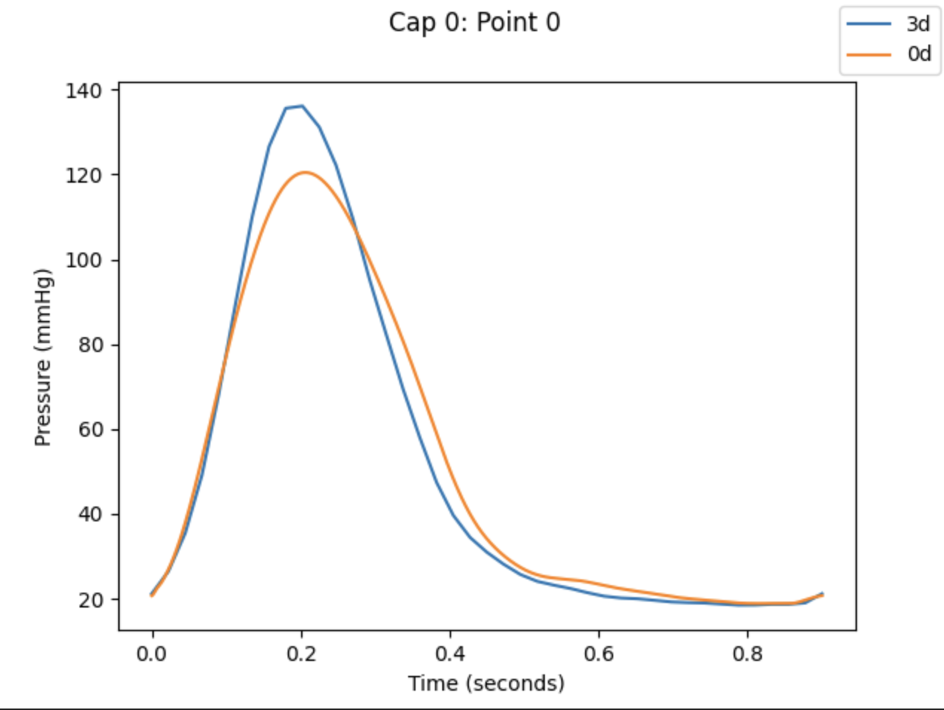
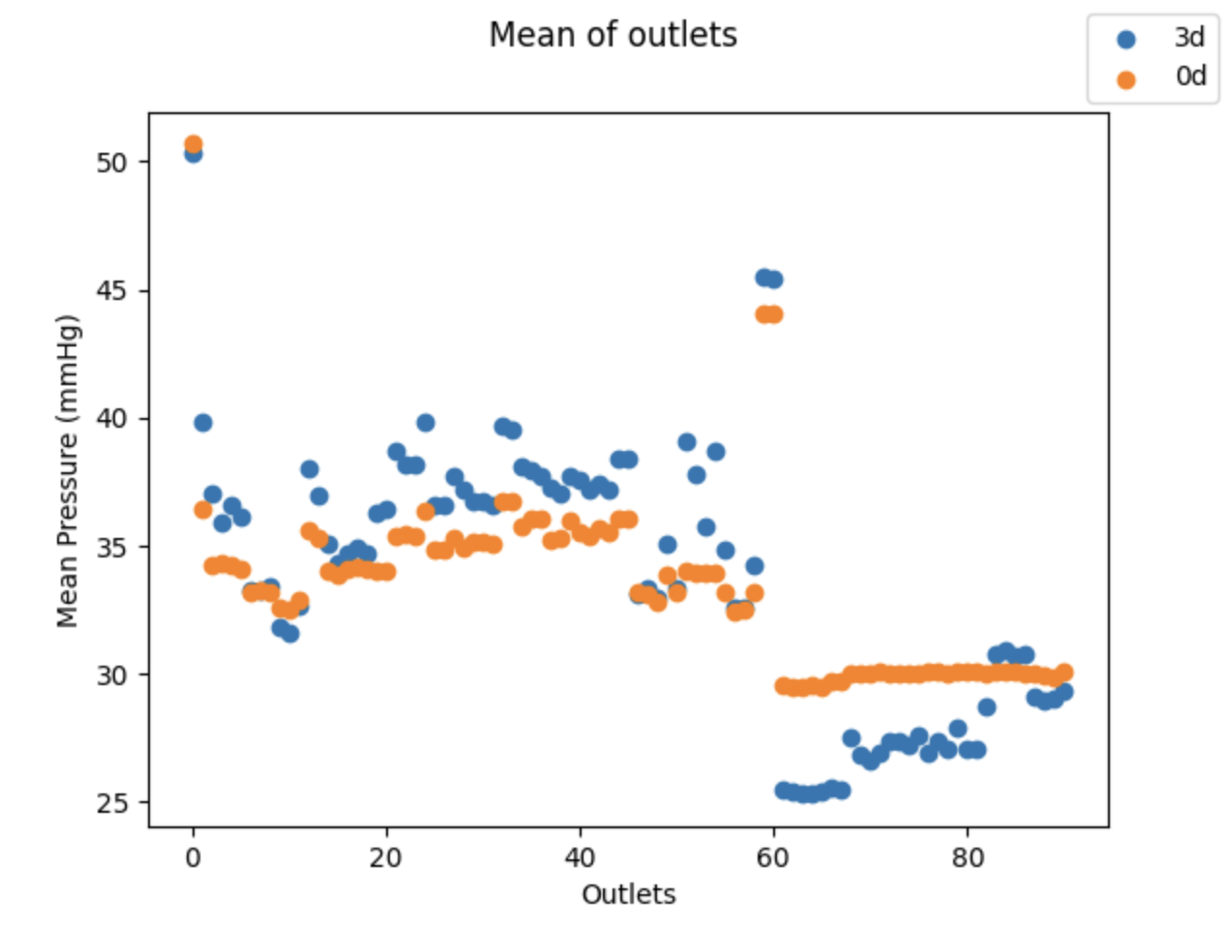
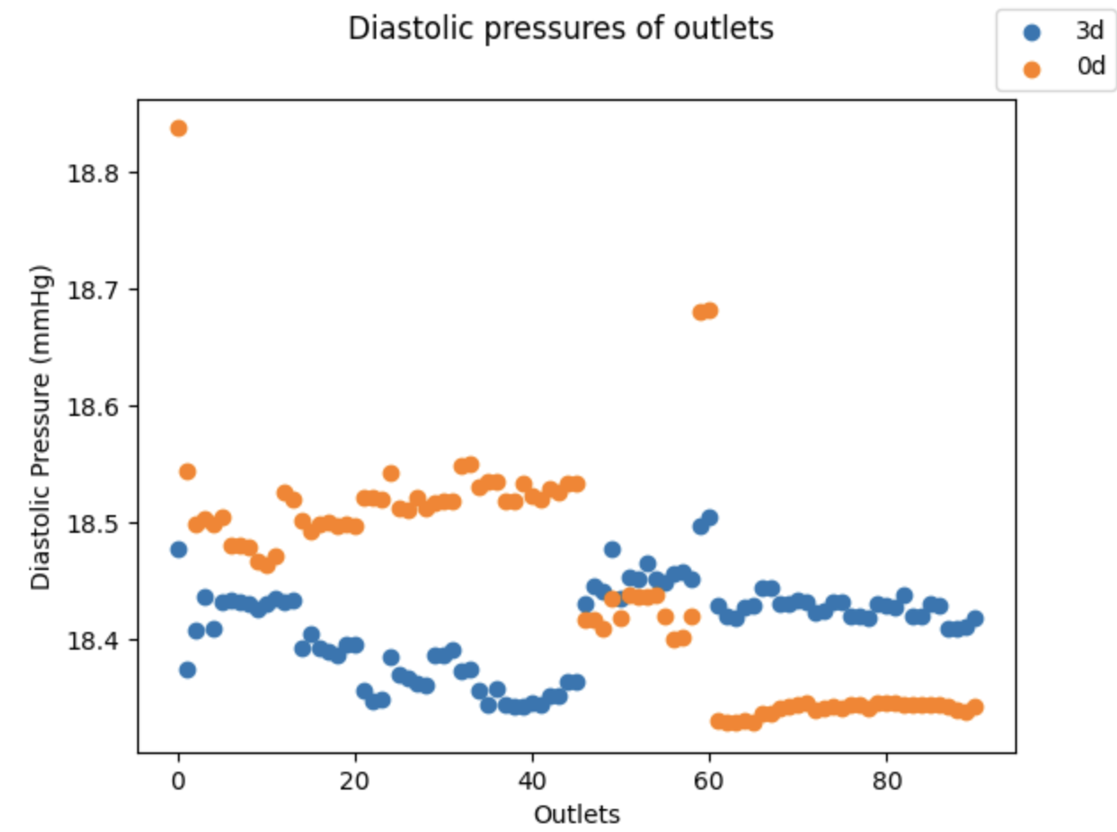
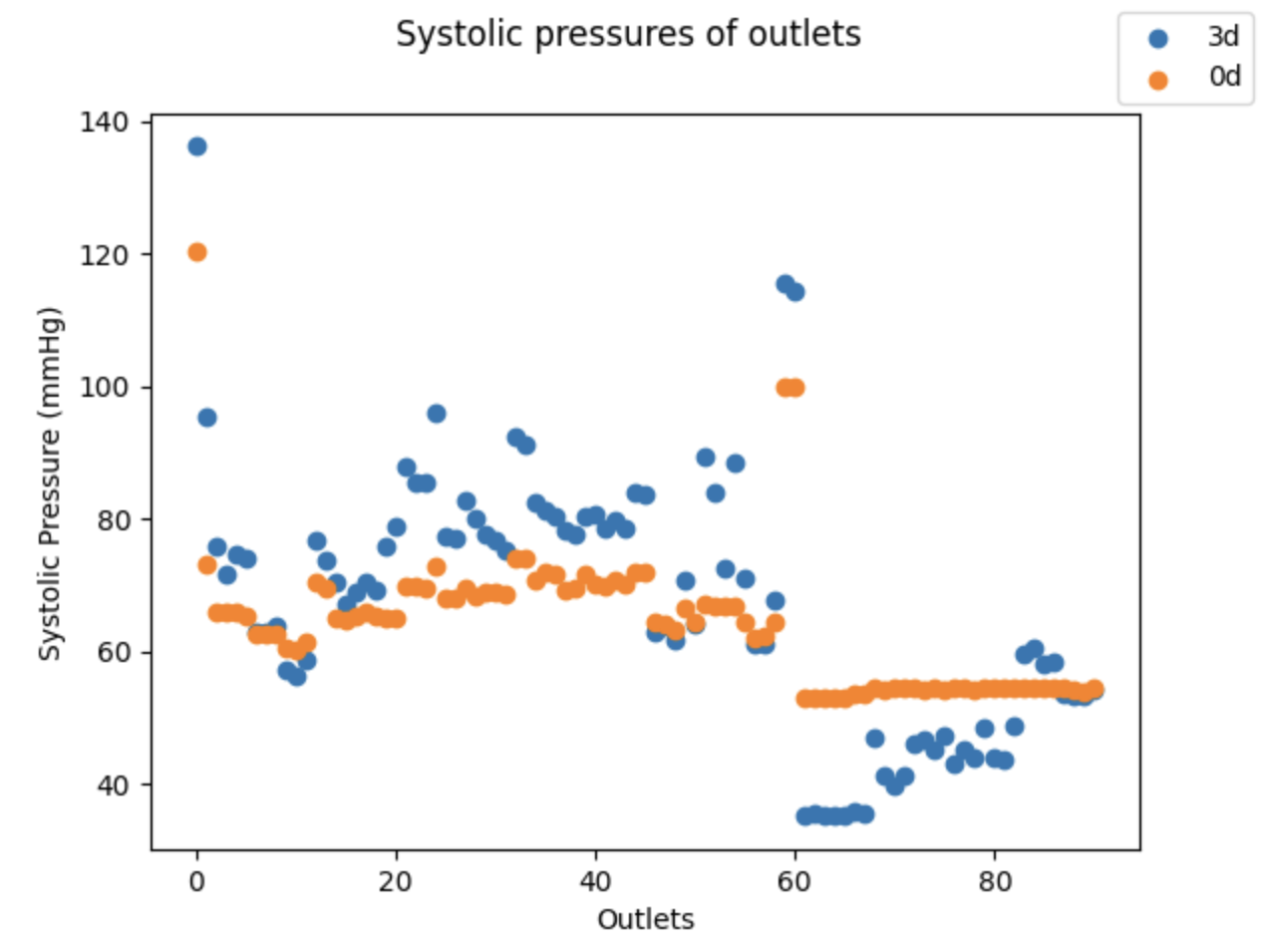
Physical Correction

Slide 14
Errors (across Outlets)
Run | Systolic |  | Mean |  | Diastolic
 | Mean Relative Error | Mean Absolute Error (mmHg) | Mean Relative Error | Mean Absolute Error (mmHg) | Mean Relative Error | Mean Absolute Error (mmHg)
No Correction | 0.258 | 15.981 | 0.129 | 4.254 | 0.002 | 0.0420
Physical Correction | 0.150 | 9.158 | 0.0620 | 1.989 | 0.005 | 0.1039

